Slide 1


Craig’s Sick Time Series Research
Featuring Long and Short term Memory, State Space Model, and Kalman and his filter
Craig Orman, intended for Dr. Farzad

Slide 2
Short Versus Long term memory
Time series are a way of modeling data that is dependent across observations over a unit of time. The AutoCorrelation Function (ACF) shows the covariance between time point t, and time point t+h. A higher absolute covariance means that the two are more dependent. Typically speaking, as h increases, the ACF converges to 0. The rate at which this convergence happens dictates which models will work well, and if it is a Long-Memory or a Short-Memory Model.

Slide 3
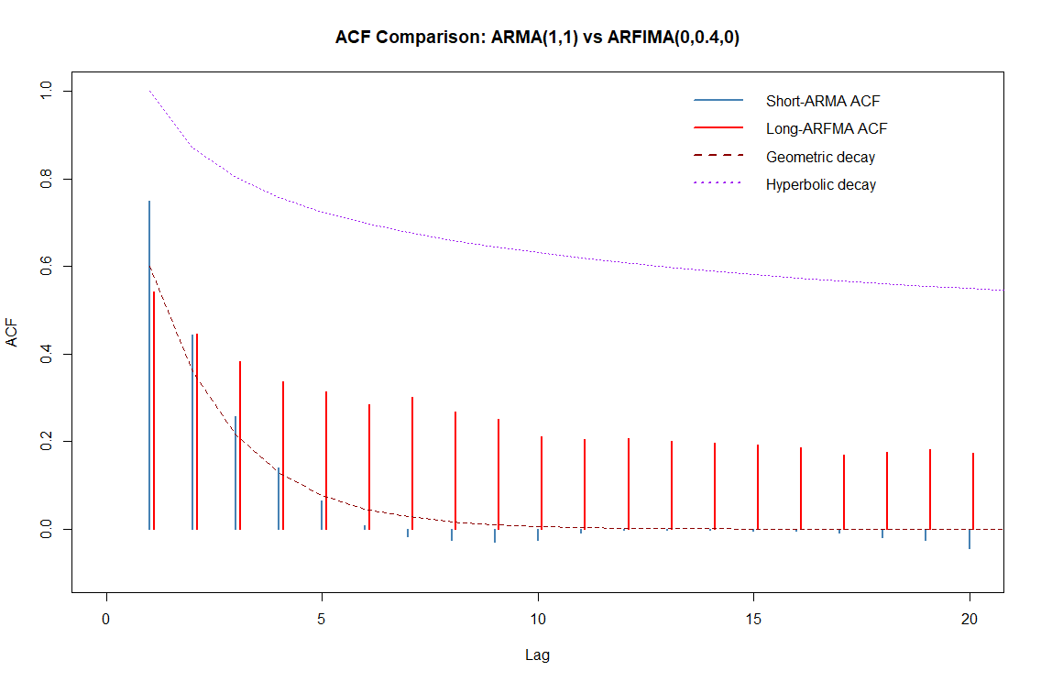
Short Versus Long term memory
Notes:
Short memory models tend to be between geometric and exponential decays
Long memory models tend towards being more than exponential and less than hyperbolic
Models with more than hyperbolic decay, and likely funky funky

Slide 4
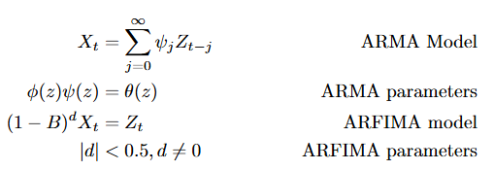
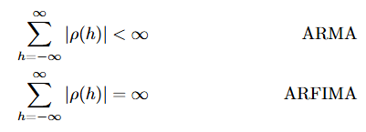
Short vs Long Equations

Slide 5
State Space Models
This is a normal content page. This type of page is useful for larger bodies of text, namely paragraph length pieces. Use this type of page for certain types of content such as extended quotes, introductory paragraphs for presentations, and other long-format pieces when necessary.

Slide 6
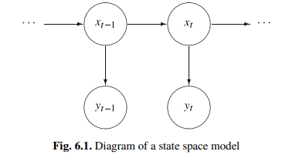
State Space Model representation
Or in math terms:

Slide 7
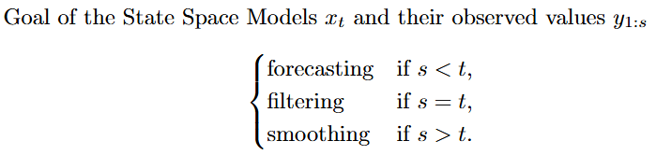
State Space Models, who cares?
Ok, say I’m interested in Filtering, how do I do that?
Answer: We ask Kalman nicely.

Slide 8
Who is Kalman and why does he filter?
Rudolf Emil Kalman (passed 2016) was a Hungarian-American Electrical Engineer, Mathematician, and inventor. Did a lot of cool stuff involving space stuff, awarded a national medal of science in 2009 by Barrack Obama.
The Kalman Filter provides a (conditionally) BLUE estimator of the current time’s state space. It can also help impute missing data values rather easily

Slide 9
How does it work?
The idea behind the work is very simple,
Predict based on lag of -1
Update based on new information
Big benefits:
BLUE
Requires only keeping a small amount of data (2 points) in memory
Out of the Box models readily available
Kalman Smooth

Slide 10
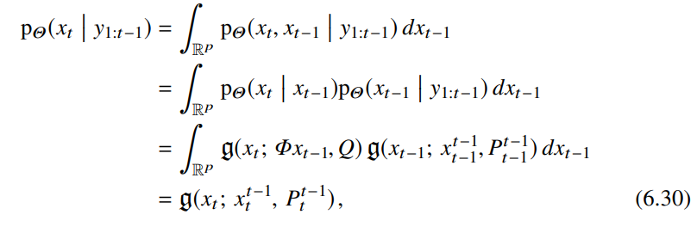
Kalman Filter mathematically
Here we see the conditional distribution of x_t. The P term is a
Covariance matrix. Its multi-variate Gaussian!

Slide 11
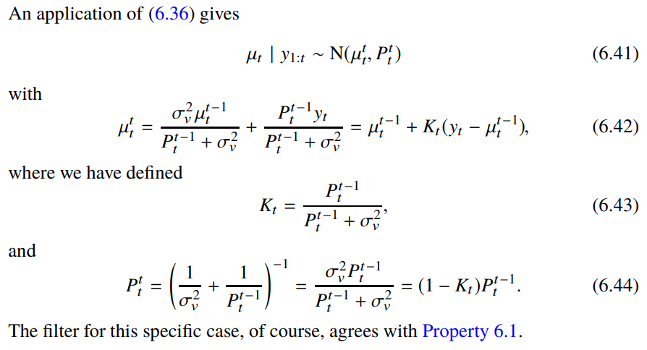
Kalman Filter mathematically
More important stuff showing that the only data-dependency is on
The previous term

Slide 12
Contact Us
Name Here
Title Here
email@iastate.edu
(515)-294-1234
www.unit.iastate.edu
Name Here
Title Here
email@iastate.edu
(515)-239-1234
www.unit.iastate.edu
Name Here
Title Here
email@iastate.edu
(515)-239-1234
www.unit.iastate.edu

